Slide 1

BillTech DACS Explorer (DACSx)
Software Roadmap

Slide 2
Introduction
BillTech DACS explorer (DACSx) is the software responsible for the BillTech Data Acquisition and Control System (DACS) hardware machine.
BillTech DACSx core follows the strategy: setup channel/axis=> acquire sensor data => visualize.
Channel/Axis can be setup from a variety of sources including USB, Bluetooth, OPC-UA, ethernet, etc.

Slide 3
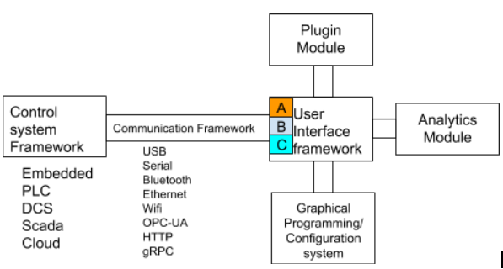
Key features (Product roadmap)
Remote/data acquisition
Data charts visualization
Graphical configuration/reprogramming
Ability to have add on features to a core user interface
Consistent user interface across desktop/web/mobile
DCS/Scada enabled
Data analytics

Slide 4
Core epic features (for MVP release)
Add Axis/channel to DACSx
Change Chart type for Axis channel
Change comm-protocol for Axis channel
Acquire Data from module into DACSx buffer
Display data from DACSx buffer
Display data from data exchange
**View Device/Axis status

Slide 5
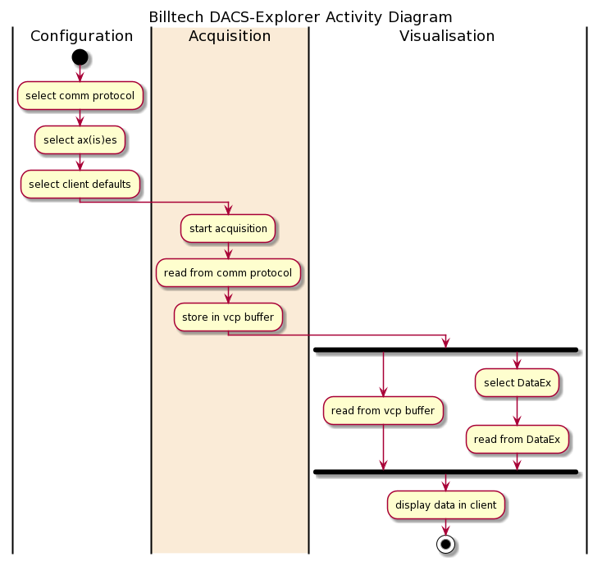
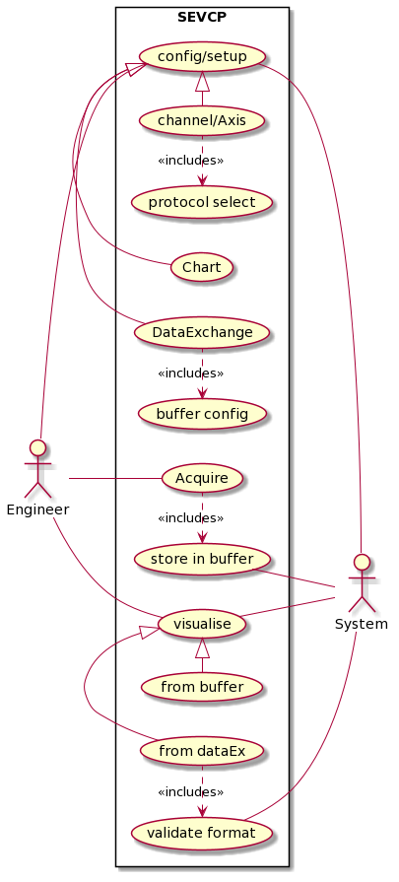
Core epic module use case and activities

Slide 6
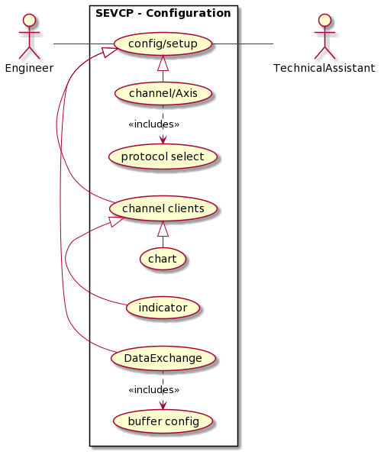
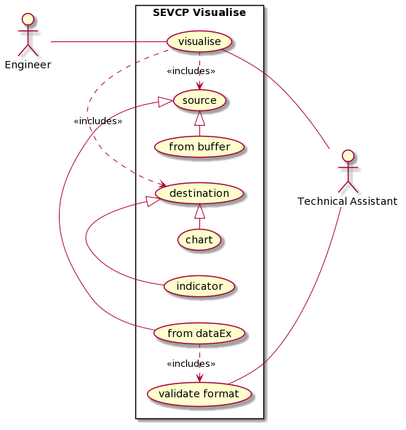
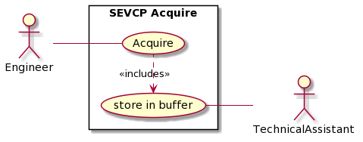
Core epic module use case and activities

Slide 7
Screens and wireframe**
Home <status management>
Configure
Device/Channel
Data-Exchange
Visualize

Slide 8
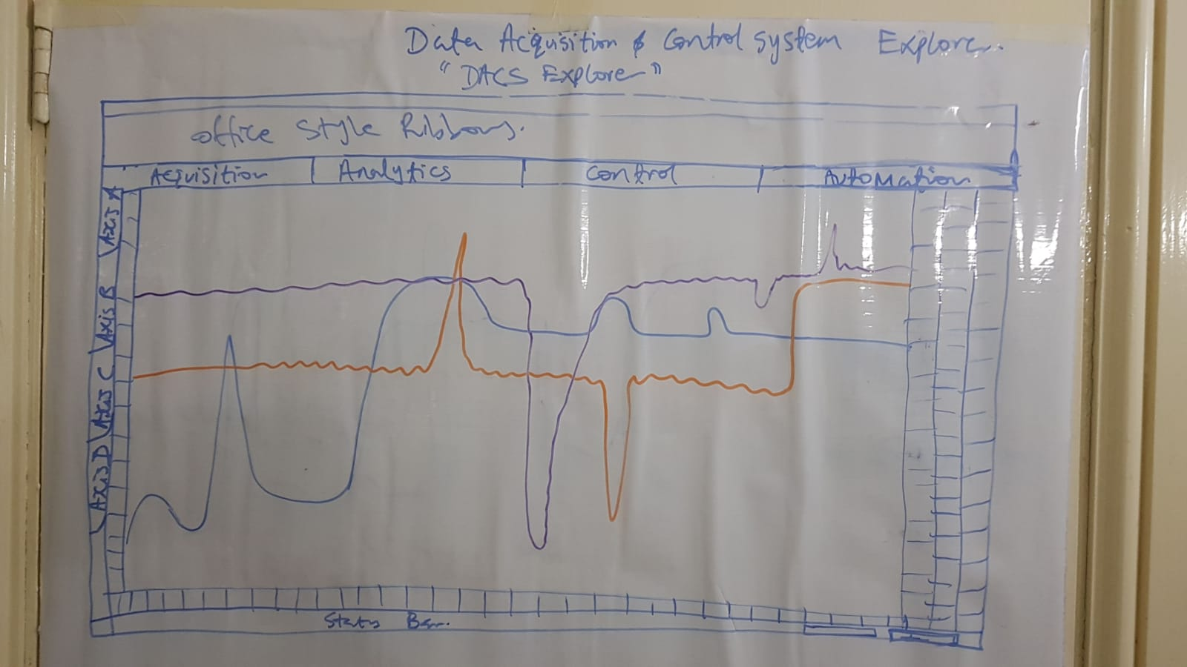
Initial Layout

Slide 9
Project Tasks
UI Design
Wireframe design
Layout design – 50% done
Screen design
Front End Development
Layout
Screen Components
Component functionality
Chart function
Presenter Models
Backend Development
System modules
Communication module
Configuration (settings) module
Home/Device status management
Channel
Channel clients
Acquisition module (streaming data model)
Data Exchange and interface Definition
Data modelling, design and implementation

Slide 10
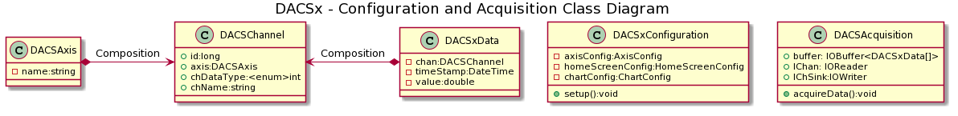
Entity Class Summary

Slide 11
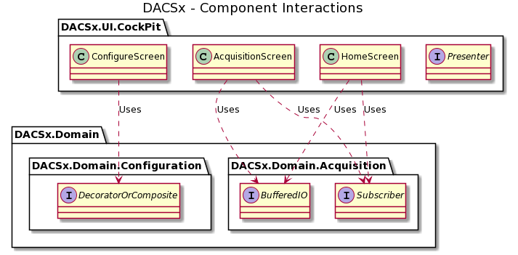
Epic Components

Slide 12
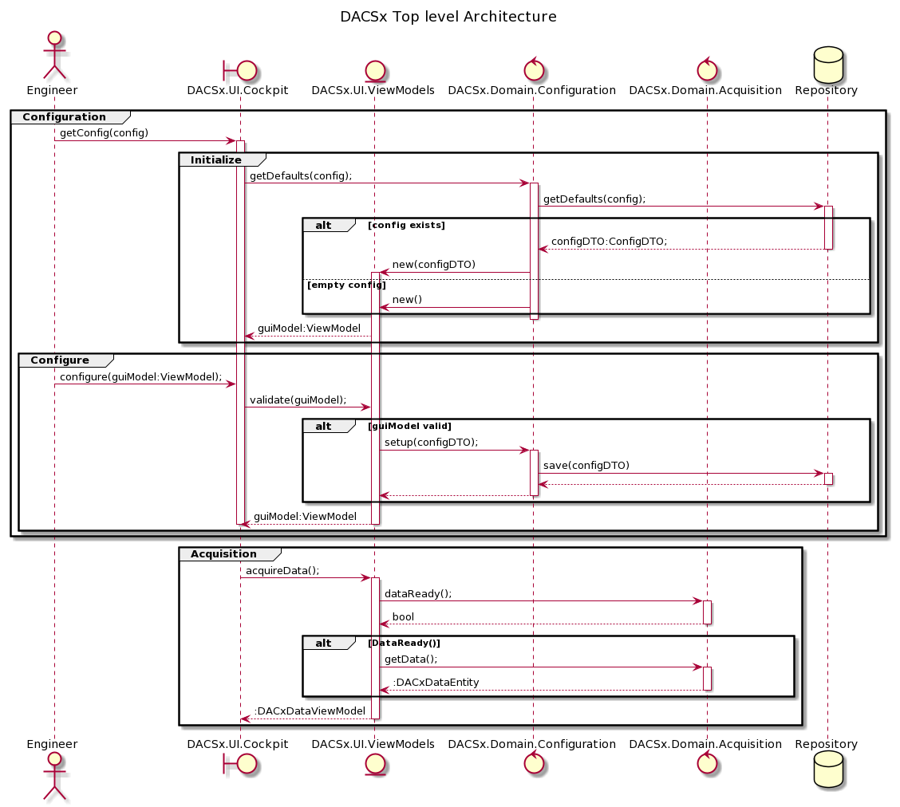
Epic Sequence diagram

Slide 13
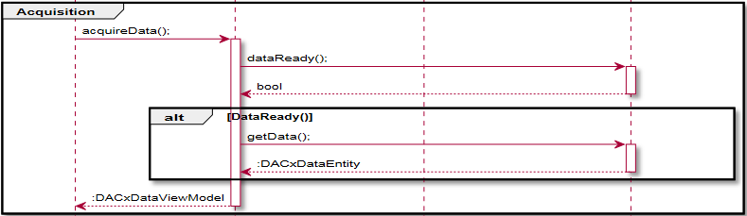
Acquisition User story
Given a preconfigured Excel Repository Source channel, a chart data sink and data buffer.
As an Engineer I would like to read from the source so that it can be displayed on the chart screen

Slide 14
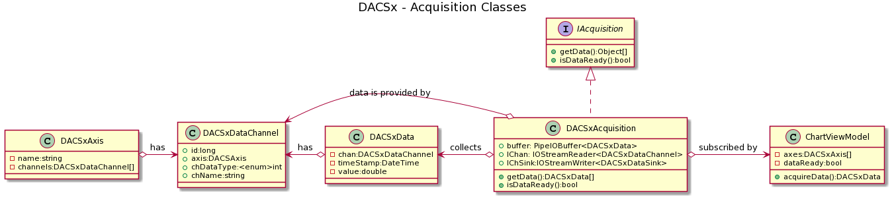
Acquisition module core class diagram

Slide 15
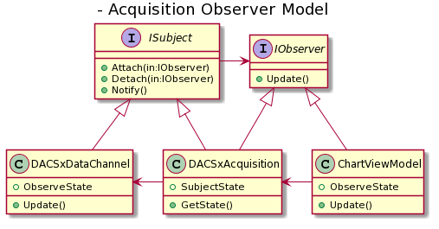
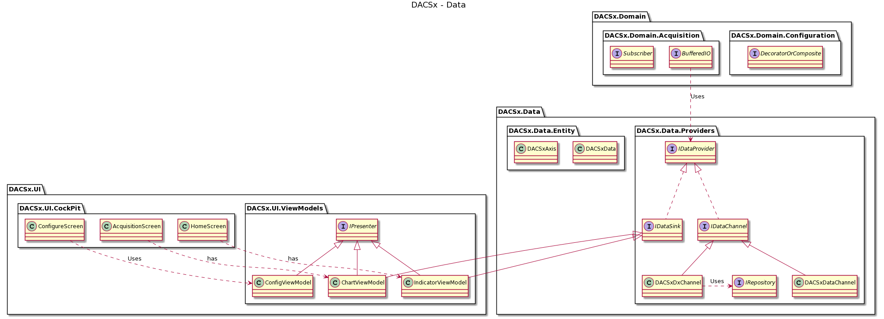
Data Component Integration

Slide 16
Core Acquisition algorithm

Slide 17
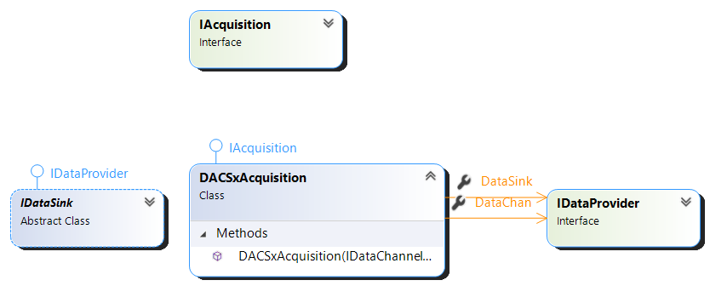
Core Acquisition Classes

Slide 18
Questions
Acquisition configuration -
data flush frequency - when should we forward/flush buffer contents? Every one, two, ten, or when requested readings?
On-demand vs automatic/background
Do we want to start mentioning what analysis will involve because this is not as clearly defined as visualization which is focused on charting as such will likely be a separate module tightly coupled with charting/visualization

